Slide 1

Chapter 13 – part II

Slide 2
OUTLINE
  Kepler’s laws.
  Spherical mass distributions.
  Problems.

Slide 3
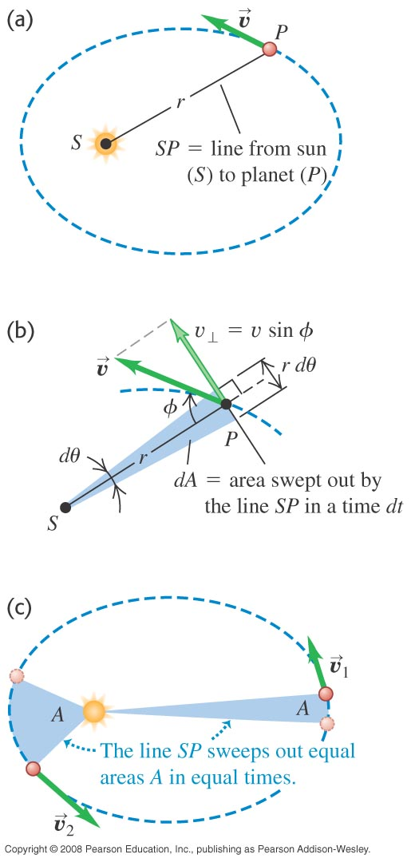
Kepler’s laws and planetary motion
Each planet moves in an elliptical orbit with the sun at one focus.
A line from the sun to a given planet sweeps out equal areas in equal times.
The periods of the planets are proportional to the ³/₂ powers of the major axis lengths of their orbits.

Slide 4
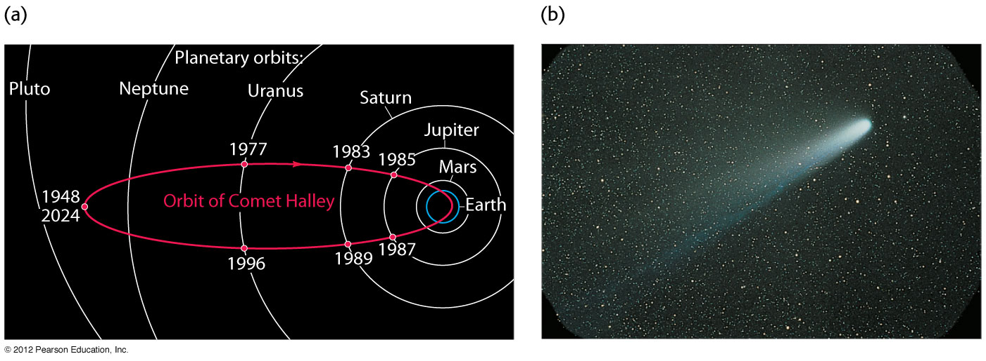
Orbital example
Comet Halley

Slide 5
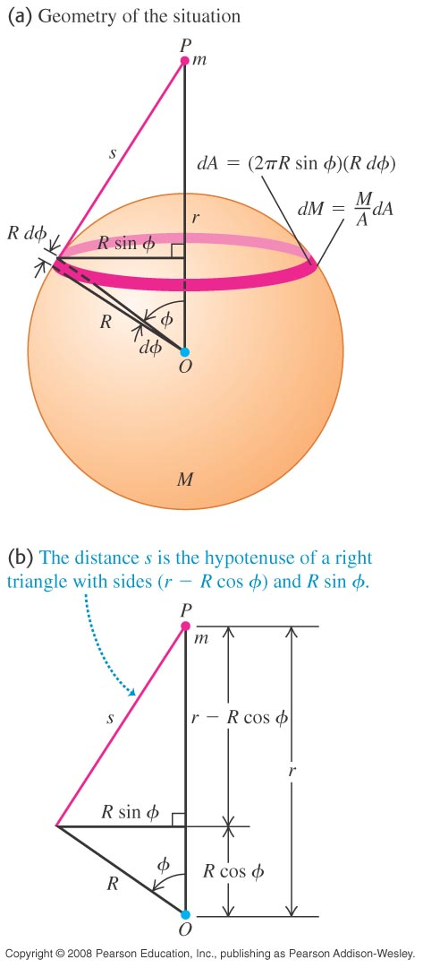
Spherical mass distributions
The gravitational interaction between two spherically symmetric mass distributions is the same as if each one were concentrated at its center.

Slide 6
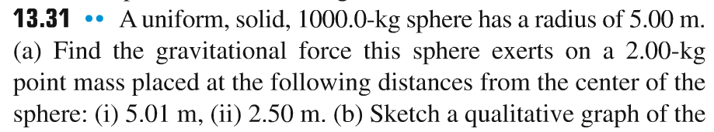
Problem #1

Slide 7
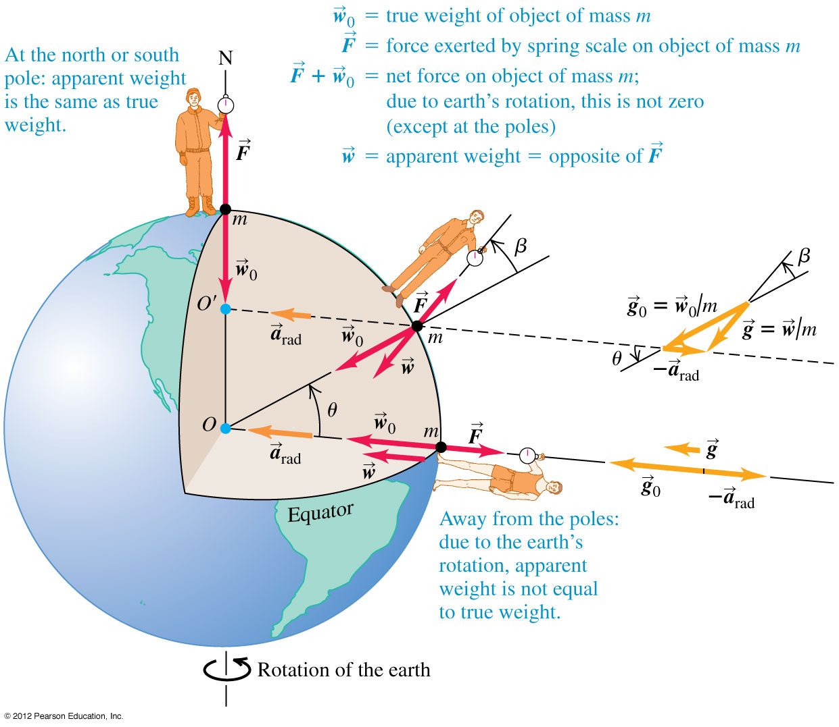
Apparent weight and the earth’s rotation
The true weight of an object is equal to the earth’s gravitational attraction on it.
The apparent weight of an object, as measured by the spring scale at the right, is less than the true weight due to the earth’s rotation.

Slide 8
Problem #2

Slide 9
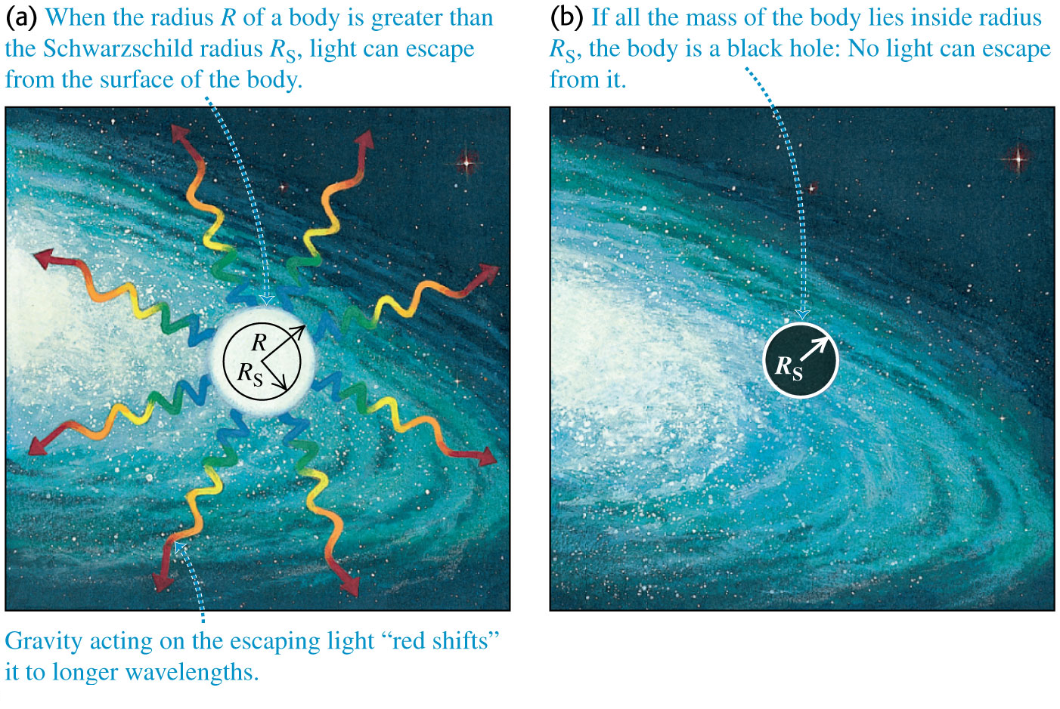
Black holes
If a spherical nonrotating body has radius less than the Schwarzschild radius, nothing can escape from it. Such a body is a black hole.
The Schwarzschild radius is R_{S} = 2GM/c².
The event horizon is the surface of the sphere of radius R_{S} surrounding a black hole.

Slide 10
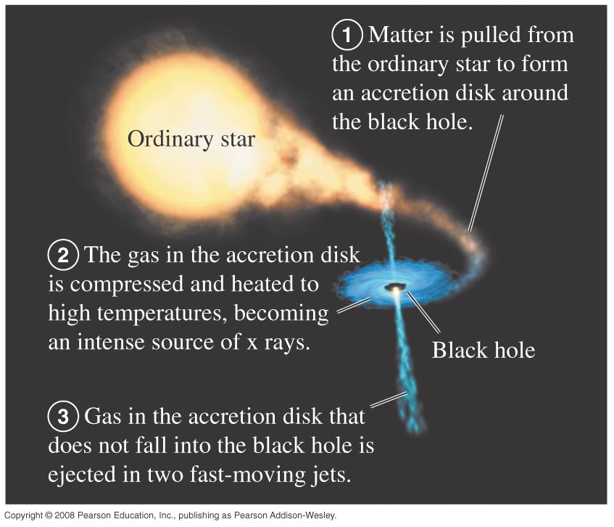
Detecting black holes
We can detect black holes by looking for x rays emitted from their accretion disks.

Slide 11
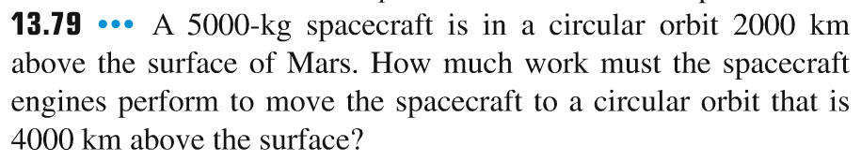
Problem #3

Slide 12
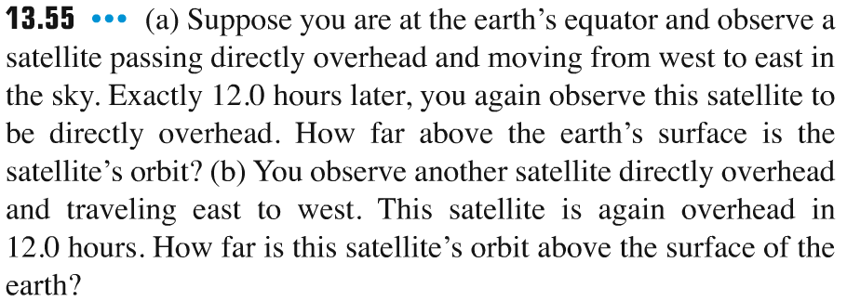
Problem #4

Slide 13
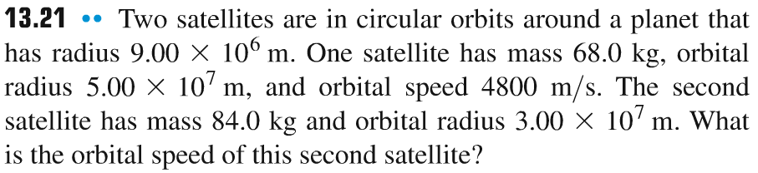
Problem #5

